Slide 1


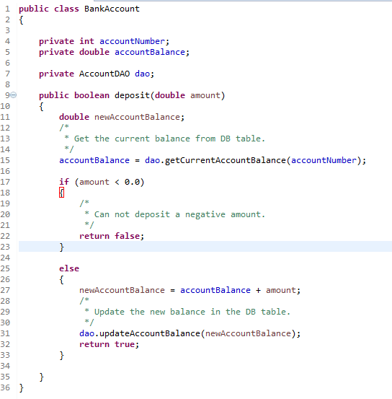
Why we use synchronization?
With out Synchronization
Expected = $1000+$200+$200 = $1400
Jack
Jill
$200
$200
HDFC
Account id | AccountBalance
1 | $1000
Account id | AccountBalance
1 | $1200
T1 [Jill Thread]
newAccountBalance = $1000+$200
newAccountBalance = $1200
Before T1 updates the balance in
HDFC table, context switching
happens and T2 starts executing.
T1 [Jill Thread]
newAccountBalance = $1000+$200
newAccountBalance = $1200
T1 resumes and updates the balance
in the HDFC table as $1200
T2 [Jack thread]
newAccountBalance = $1000+$200
newAccountBalance = $1200
T2 updates the balance in the
HDFC table as $1200.

Slide 2
Why we use synchronization?
You've now seen the example in previous slide , let's get into the problems that we can run into when we have a multi-threaded application. The problem that we will be presenting in previous slide is what's called a race condition. A race condition occurs when a program or application malfunctions because of an unexpected ordering of events that produces contention over the same resource. That sounds confusing, but it will make a lot more sense once you read the example below.
So, let’s get into the actual problem. Let’s say that there’s a husband and wife - Jack and Jill - who share a joint account. They currently have $1,000 in their account. They both log in to their online bank account at the same time, but from different locations.
They both decide to deposit $200 each into their account through a wire transfer from other bank accounts that they have at the same time. So, the total account balance after these 2 deposits should be $1,000 + ($200 * 2), which equals $1,400.
Let’s say Jill’s transaction goes through first, but Jill's thread of execution is switched out (to Jack’s transaction thread) right after executing this line of code in the deposit method:
Now, the processor is running the thread for Jack, who is also depositing $200 into their account. When Jack’s thread deposits $200, the account balance is still only $1,000, because the HDFC table has not yet been updated in Jill’s thread. Remember that Jill’s thread stopped execution right before the HDFC table updated with new balance.
So, Jack’s thread runs until it completes the deposit function, and then updates the value in the HDFC table as $1200. After this, control returns to Jill’s thread, where newAccountBalance has the value of $1200. Then, it just update this value of $1,200 to HDFC table and returns. And that is the end of execution.
What is the result of these 2 deposits of $200? Well, the Balance in HDFC table ends up being set to only $1200, when it should have been $1400. This means Jack and Jill lost $200. This is good for the bank, but a huge problem for Jack and Jill, and any other of the bank's customers.

Slide 3
Why we use synchronization?
The cause of the race condition and how to fix?
So, do you see how the problem was caused here? Because Jill’s thread switched out (to Jack’s thread) right before the AccountBalance value was updated in HDFC table, Jill’s deposit was not counted.
If you remember the definition of a race condition, the example we just gave should clear it up. Here's the definition of a race condition again, in case you forgot: A race condition occurs when a program or application malfunctions because of an unexpected ordering of events that produces contention over the same resource. Hopefully, now it makes a lot more sense.
But the real question is how can this problem be fixed? Well, it should be clear that the code needs to allow the deposit function to run to completion without switching to run a different thread. This is what synchronization is all about - fixing issues like this! This can be accomplished with a synchronization construct like a monitor.
This problem is easily fixed in Java. In the code , all we do is add the synchronized keyword to the deposit method to create a monitor.
What does the synchronized keyword do for us here? Well, if a thread is executing inside the deposit block, then it is now impossible for any other threads to enter deposit method. This means that only one thread can execute the deposit method at a time - which is exactly what we want to prevent the race condition issue.

Slide 4
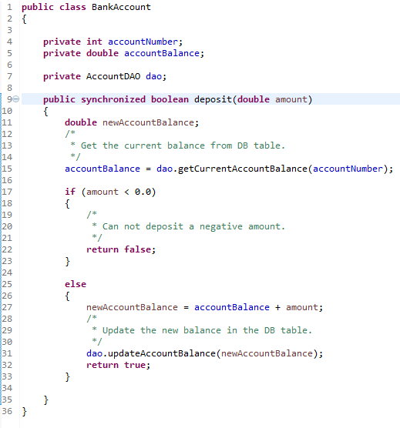
Why we use synchronization?
With out Synchronization
Expected = $1000+$200+$200 = $1400
Jack
Jill
$200
$200
HDFC
Account id | AccountBalance
1 | $1000
Account id | AccountBalance
1 | $1200
Account id | AccountBalance
1 | $1400
deposit method is synchronized, So
at a time only one thread can execute
The method.
T1 [Jill Thread]
newAccountBalance = $1000+$200
newAccountBalance = $1200
T1 updates the balance in
HDFC table as $1200.
Once T1 finishes T2 starts
T2 [Jack thread]
newAccountBalance = $1200+$200
newAccountBalance = $1400
T2 updates the balance in the
HDFC table as $1400.

